Slide 1
Design and Implement Cloud Data Platform Solutions

Slide 2
06 | Design and Implement Security

Slide 3
Agenda
1
Microsoft Data Platform
5
Hybrid HA/DR Scenarios with SQL Server
2
Implement SQL Server on Azure VM
6
Design and Implement Security
3
Implement SQL Database
7
Monitor and Manage Implementations on Azure
4
SQL Database High Availability and Disaster Recovery
8
Design and Implement Database Solutions for SQL Server and SQL Database

Slide 4
In this module
SQL Database Security Approach
Row Level Security
SQL Database Firewall Security
Dynamic Data Masking
SQL Database Active Directory Integration
Auditing and Threat Detection
Encryption

Slide 5
SQL Database Security

Slide 6

Layered Approach to Security
Securing your database
Firewall
Users and Permissions
Connection string encryption
Securing your data
Encryption
Data Masking
Row-level Security
Securing changes to your data
Application and user activity auditing
APP
SQL Database

Slide 7
Securing your database with firewalls
Internet
Microsoft Azure
Initially, all access to your Azure SQL Database server is blocked by the firewall. In order to begin using your Azure SQL Database server, you must go to the Azure Management Portal and specify one or more server-level firewall rules that enable access to your Azure SQL Database server. Use the firewall rules to specify which IP address ranges from the Internet are allowed, and whether or not Azure applications can attempt to connect to your Azure SQL Database server.
However, if you want to selectively grant access to just one of the databases in your Azure SQL Database server, you must create a database-level rule for the required database with an IP address range that is beyond the IP address range specified in the server-level firewall rule, and ensure that the IP address of the client falls in the range specified in the database-level rule.
Connection attempts from the Internet and Azure must first pass through the firewall before they can reach your Azure SQL Database server or database, as shown in the following diagram.
SQL Database Firewall
Server-Level Firewall Rules
Client IP Address in Range?
No
Database-Level Firewall Rule for Database 4
Yes
Client IP Address in Range?
No
Connection Fails
Yes
Database with a database-level firewall rule
Database 1
Database 2
Database 3
Database 4
SQL Database Server
Microsoft Azure Platform

Slide 8
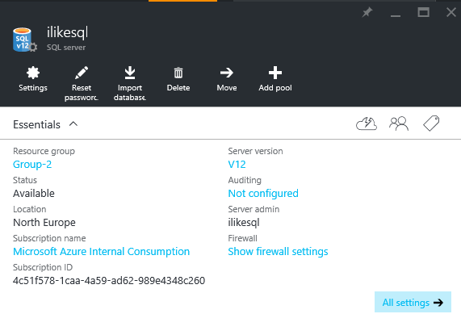
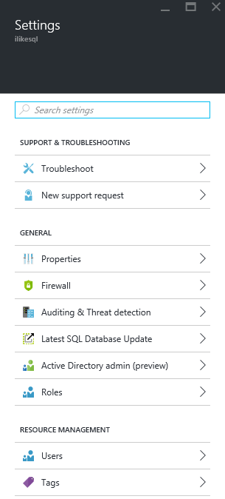
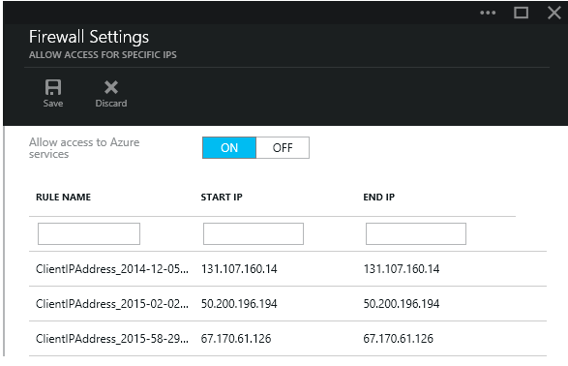
Firewall configuration using portals
By default, Azure blocks all external connections to port 1433.
Enabled in the following ways:
Azure portal
Classic portal: Server level – configure page
New portal: Server settings – firewall – firewall settings blade

Slide 9
Firewall configuration using PowerShell/T-SQL
# PS Enable Azure connections
PS C:\> New-AzureSqlDatabaseServerFirewallRule `
-ServerName "Contoso" `
-AllowAllAzureServices `
-RuleName "myRule2"
-- PS Allow external IP access to SQL Database
PS C:\> New-AzureSqlDatabaseServerFirewallRule `
-ServerName "Contoso" `
-RuleName "myRule1" `
-StartIpAddress 12.1.1.1 `
-EndIpAddress 12.1.1.2
-- T-SQL Enable Azure connections
sp_set_firewall_rule N'Allow Windows Azure',
'0.0.0.0','0.0.0.0'
-- T-SQL Allow external IP access to SQL Database
sp_set_firewall_rule N'myRule1',
'12.1.1.1','12.1.1.2'
Manage SQL Database firewall rules using code.
Windows PowerShell Azure cmdlets
New-AzureSqlDatabaseServerFirewallRule
Get-AzureSqlDatabaseServerFirewallRule
Set-AzureSqlDatabaseServerFirewallRule
Transact SQL
sp_set_firewall_rule
sp_set_database_firewall_rule
sp_delete_firewall_rule
sp_delete_database_firewall_rule

Slide 10
Firewall configuration using REST API
POST
https://management.core.windows.net:8443/{subscriptionId}/services/sqlservers/servers/Contoso/firewallrules
REQUEST BODY
<ServiceResource xmlns="http://schemas.microsoft.com/windowsazure">
<Name>myRule1</Name>
<StartIPAddress> 12.1.1.1 </StartIPAddress>
<EndIPAddress> 12.1.1.1 </EndIPAddress>
</ServiceResource>
DELETE
https://management.core.windows.net:8443/{subscriptionId}/services/sqlservers/servers/Contoso/firewallrules/myRule1
GET
https://management.core.windows.net:8443/{subscriptionId}/services/sqlservers/servers/Contoso/firewallrules
Managing firewall rules through REST API must be authenticated. For information, see Authenticating Service Management Requests.
Server-level rules can be created, updated, or deleted using REST API.
To create or update a server-level firewall rule, execute the POST method.
To remove an existing server-level firewall rule, execute the DELETE method.
To list firewall rules, execute the GET.

Slide 11
Overview SQL Database Security Administration
Point of Difference | On-premises SQL Server | Microsoft Azure SQL Database
Where you manage server-level security | The Security folder in SQL Server Management Studio's Object Explorer | The master database
Server-level security role for creating logins | securityadmin fixed server role For more information, see Server-Level Roles | loginmanager database role in the master database
Commands for managing logins | CREATE LOGIN ALTER LOGIN DROP LOGIN | CREATE LOGIN ALTER LOGIN DROP LOGIN (There are some parameter limitations and you must be connected to the master database)
View that shows all logins | sys.syslogins (sys.sql_logins for SQL Server authentication logins) | sys.sql_logins (You must be connected to the master database)
Server-level role for creating databases | dbcreator fixed database role For more information, see Server-Level Roles | dbmanager database role in the master database
Command for creating a database | CREATE DATABASE | CREATE DATABASE (There are some parameter limitations and you must be connected to the master database)
Dropping databases | DROP DATABASE | DROP DATABASE If a user is in the dbmanager role, they have permission to DROP any database, regardless of which user originally created it.
View that lists all databases | sys.databases (view) | sys.databases (You must be connected to the master database)

Slide 12
Azure Active Directory integration
Centrally manage user permissions
Alternative to SQL Server authentication
Limits proliferation of user identities across databases
Allows password rotation in a single place
Enables management of database permissions using external Azure Active Directory groups
Stops password storing by using integrated Windows authentication and other forms of authentication supported by Azure Active Directory
Status: Public preview

Slide 13
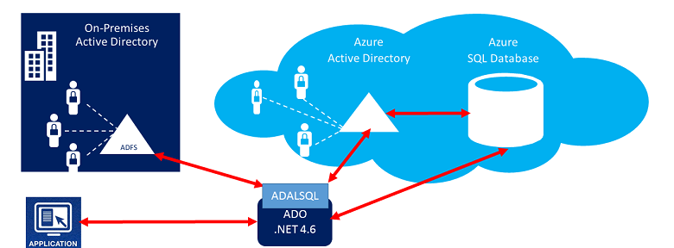
Trust architecture
Azure Active Directory and Azure SQL Database
SQL Server Management Suite
SQL Server Data Tools
Azure Active Directory Authentication Library for SQL Server (ADALSQL)
Status: Public preview

Slide 14
Encryption Overview
Encryption Type | Type | Customer Value
Encryption-In-Transit | TLS from Client to Server TLS = Transport Layer Security | Protects data between client and server against snooping & man-in-the-middle attacks. SQL DB is phasing out SSL 3.0 and TLS 1.0 in favor of TLS 1.2.
Encryption-At-Rest | TDE for SQL DB TDE = Transparent Data Encryption | Protects data on disk. Key management done by Azure. Makes it easier to obtain compliance.
Encryption-End-To-End | Client-side column encryption for SQL DB (library available for download) | Data protected end-to-end but application is aware of encrypted columns. Used in the absence of data masking and TDE for compliance related scenarios.
End-To-End
In-Transit
At-Rest
Customer Data
Database Files, Backups, Tx Log, TempDB

Slide 15
Transparent data encryption
All customer data is encrypted at rest
Data is encrypted at rest, in flight, and while in use
Azure SQL Database service manages your keys
You can keep application changes to a minimum
Encryption and decryption of data is done transparently in a transparent data encryption (TDE)–enabled client driver
Support for equality operations (including joins) on encrypted data
Azure manages encryption keys
Azure SQL Database

Slide 16
Demo
Enabling TDE

Slide 17
Always encrypted
Protect data at rest and in motion, both on-premises and in the cloud
Data remains encrypted during query
Capability
Transparent client-side encryption, while SQL Server executes T-SQL queries on encrypted data
Benefits
Sensitive data remains encrypted and queryable at all times, both on-premises and in the cloud
Unauthorized users never have access to data or keys
No changes to applications are necessary
Apps
Encrypted query
Always Encrypted ADO.NET library
SQL Server
No app changes
Master key
Encrypted columnar key

Slide 18
How it works
Encrypted sensitive data and its corresponding keys are never seen in plaintext in SQL Server
Trusted—Client
Untrusted—SQL Server
ADO.NET
"SELECT Name FROM Customers WHERE SSN = @SSN",
"111-22-3333"
"SELECT Name FROM Customers WHERE SSN = @SSN",
0x7ff654ae6d
ciphertext
Result Set
Result Set
Name
Jim Gray
Name
0x19ca706fbd9a
dbo.Customers
ciphertext
Name | SSN | Country
0x19ca706fbd9a | 0x7ff654ae6d | USA
Mission-critical performance

Slide 19
Row-level security
Protect data privacy by ensuring the right access across rows
Fine-grained access control over specific rows in a database table
Help prevent unauthorized access when multiple users share the same tables, or to implement connection filtering in multitenant applications
Administer via SQL Server Management Studio or SQL Server Data Tools
Enforcement logic inside the database and schema bound to the table.
Customer 1
Customer 2
Customer 3
SQL Database
Status: Public preview

Slide 20
RLS in three steps
Two App user (e.g., nurse) selects from Patients table
Three Security Policy transparently rewrites query to apply filter predicate
One Policy manager creates filter predicate and security policy in T-SQL, binding the predicate to the Patients table
Nurse
Database
Policy Manager
Security
Policy
Filter Predicate:
INNER JOIN…
Application
Patients
CREATE FUNCTION dbo.fn_securitypredicate(@wing int)
RETURNS TABLE WITH SCHEMABINDING AS
return SELECT 1 as [fn_securitypredicate_result] FROM
StaffDuties d INNER JOIN Employees e
ON (d.EmpId = e.EmpId)
WHERE e.UserSID = SUSER_SID() AND @wing = d.Wing;
CREATE SECURITY POLICY dbo.SecPol
ADD FILTER PREDICATE dbo.fn_securitypredicate(Wing) ON Patients
WITH (STATE = ON)
SELECT * FROM Patients
SEMIJOIN APPLY dbo.fn_securitypredicate(patients.Wing);
SELECT * FROM Patients
SELECT Patients.* FROM Patients,
StaffDuties d INNER JOIN Employees e ON (d.EmpId = e.EmpId)
WHERE e.UserSID = SUSER_SID() AND Patients.wing = d.Wing;

Slide 21
Create Security Policy
Creates a security policy for row level security.
The following examples demonstrate the use of the CREATE SECURITY POLICY syntax.
For an example of a complete security policy scenario, see Row Level Security.
-- The following syntax creates a security policy with a filter predicate for the Customer table, and leaves the security policy disabled
CREATE SECURITY POLICY [FederatedSecurityPolicy]
ADD FILTER PREDICATE [rls].[fn_securitypredicate]([CustomerId])
ON [dbo].[Customer];
-- Create a new schema and predicate function, which will use the application user ID stored in CONTEXT_INFO to filter rows.
CREATE FUNCTION rls.fn_securitypredicate (@AppUserId int)
RETURNS TABLE
WITH SCHEMABINDING
AS
RETURN (
SELECT 1 AS fn_securitypredicate_result
WHERE
DATABASE_PRINCIPAL_ID() = DATABASE_PRINCIPAL_ID('dbo') -- application context
AND CONTEXT_INFO() = CONVERT(VARBINARY(128), @AppUserId);
GO

Slide 22
Demo
Row Level Security

Slide 23
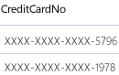
Dynamic Data Masking
Prevent the abuse of sensitive data by hiding it from users
Table.CreditCardNo
4465-6571-7868-5796
4468-7746-3848-1978
4484-5434-6858-6550
Configuration made easy in the new Azure portal
Policy-driven at the table and column level, for a defined set of users
Data masking applied in real-time to query results based on policy
Multiple masking functions available (e.g., full, partial) for various sensitive data categories (e.g., Credit Card Numbers, SSN, etc.)
SQL Database
Real-time data masking; partial masking

Slide 24
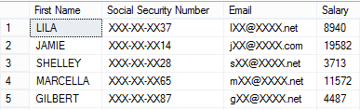
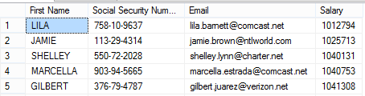
Dynamic data masking
2) The app user selects from the Employee table
Security officer defines dynamic data masking policy in T-SQL over sensitive data in the Employee table
3) The dynamic data masking policy obfuscates the sensitive data in the query results
SELECT Patients.* FROM Patients,
StaffDuties d INNER JOIN Employees e ON (d.EmpId = e.EmpId)
WHERE e.UserSID = SUSER_SID() AND Patients.wing = d.Wing;
ALTER TABLE [Employee] ALTER COLUMN [SocialSecurityNumber]
ADD MASKED WITH (FUNCTION = ‘SSN()’
ALTER TABLE [Employee] ALTER COLUMN [Email]
ADD MASKED WITH (FUNCTION = ‘EMAIL()’)
ALTER TABLE [Employee] ALTER COLUMN [Salary]
ADD MASKED WITH (FUNCTION = ‘RANDOM(1,20000)’)
GRANT UNMASK to admin1
Security
Officer
other logon
admin1 logon
SELECT [Name],
[SocialSecurityNumber],
[Email],
[Salary]
FROM [Employee]
SELECT * FROM patients
SEMIJOIN APPLY dbo.fn_securitypredicate(patients.Wing);

Slide 25
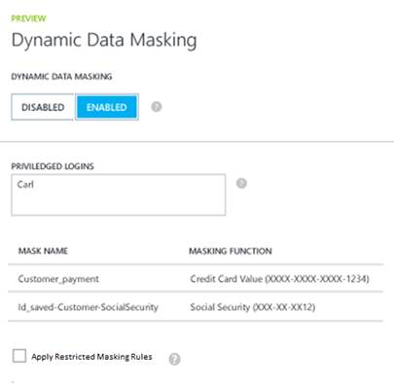
Minimal Impact on Applications
Existing Application queries will not be affected
The sensitive data is been masked in the result set of a query
An option to restrict masking policy is available to limit developers with direct access
Complimentary to other security features that protect sensitive data
Limit access by setting firewall rules and user roles with minimal permissions
Encrypt sensitive data at rest
Use auditing for tracking discrepancies and anomalies activities

Slide 26
Demo
Dynamic Data masking

Slide 27
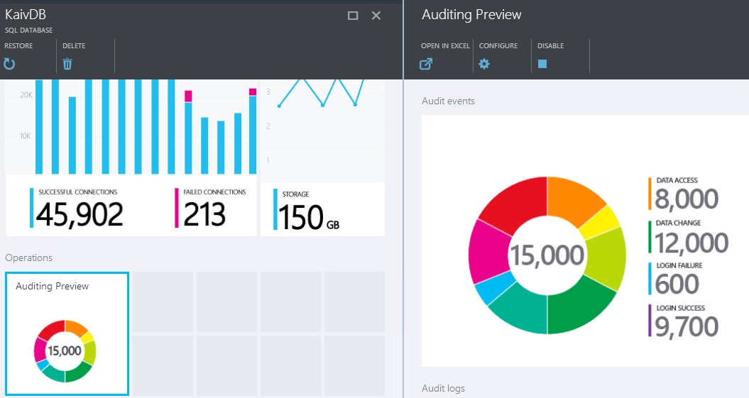




Auditing and Threat Detection
Gain insight into database events and streamline compliance-related tasks
Audit
log
Configurable to track and log database activity
Dashboard views in the portal for at-a-glance insights
Azure Storage
SQL
Database
Auditing
Application data

Slide 28
Demo
Auditing and Threat Detection

Slide 29
Hands-on Lab
Design and Implement SQL Database Security

